Slide 1
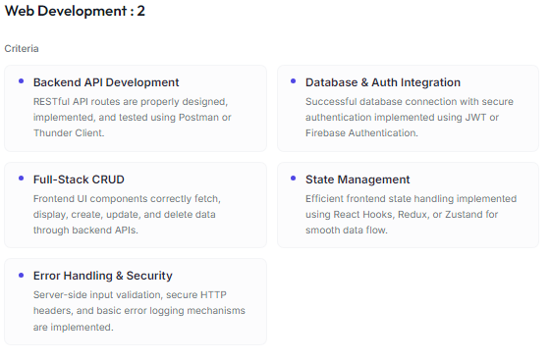
PROJECT REVIEW – PHASE 2
DIGITAL PROCESS BENCHMARKING TOOL
PRESENTED BY
ASHOK J
[7376241EC502]
PBL BASED FULLSTACK PROJECT
DEPT. : ELECTRONICS & COMMUNICATION ENGINEERING
DATE : 12/02/2026

Slide 2
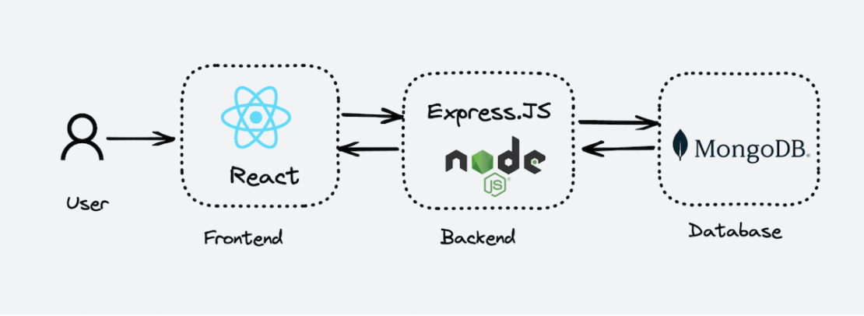
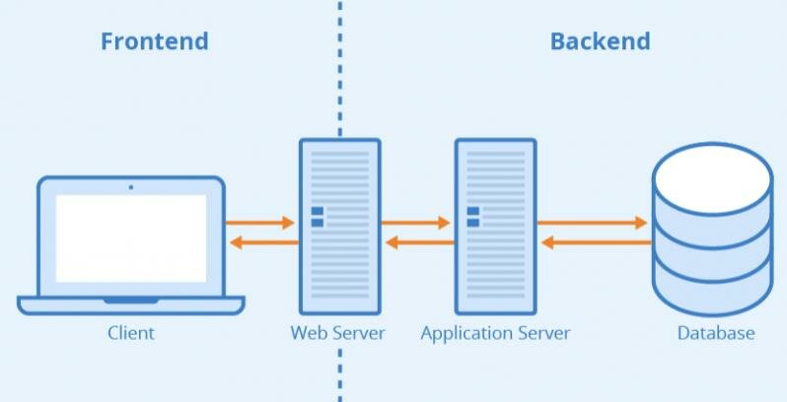
IMPLEMENTATION OVERVIEW
Implemented core full-stack features including:
Backend API Development
Database & Authentication Integration
Full Stack CRUD Operations
State Management
Error Handling & Security
Additional enhancements:
Email Report System
Benchmark Comparison Charts
CSV / JSON Export
Modern UI Theme System

Slide 3
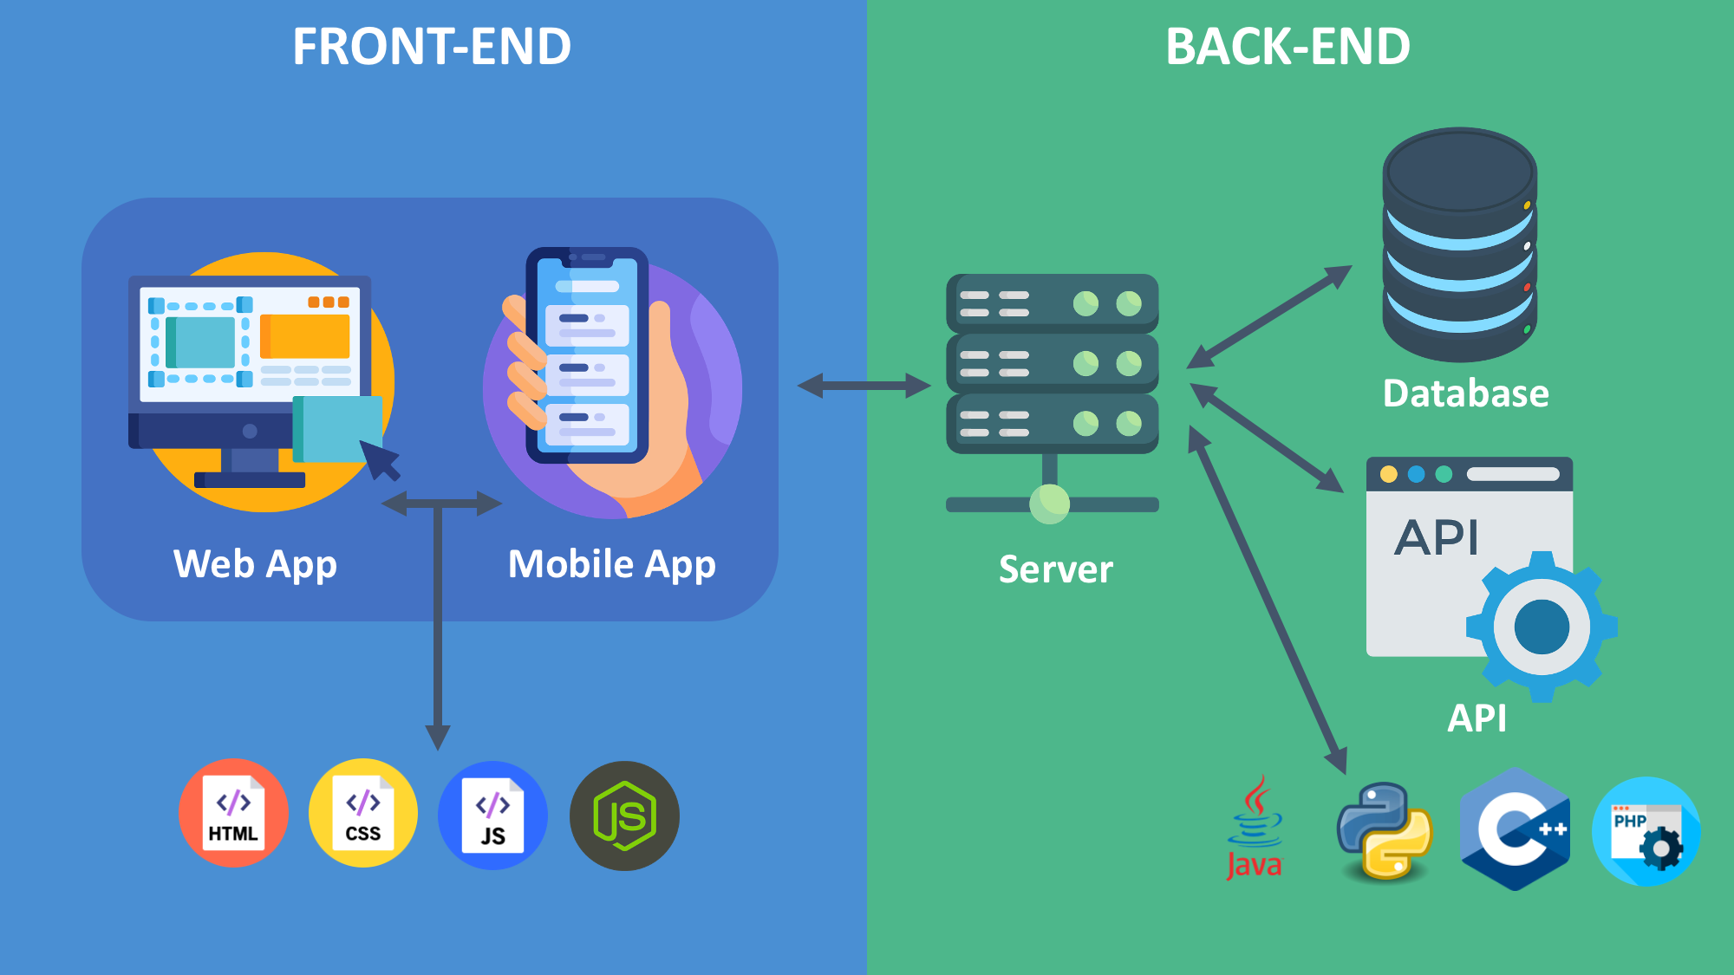
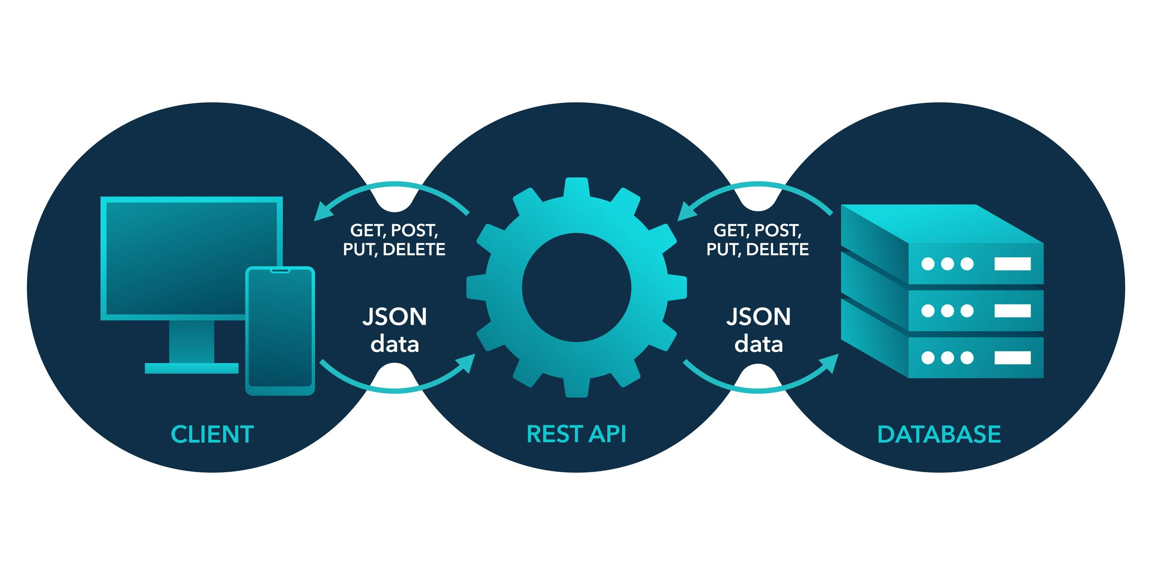
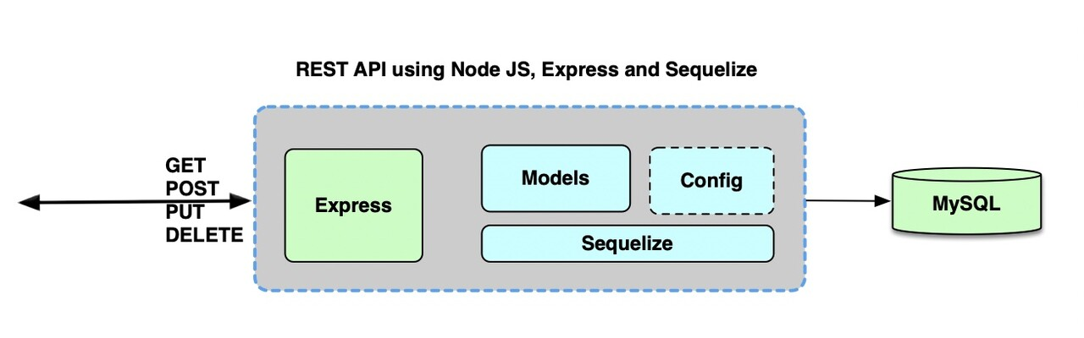
BACKEND API DEVELOPMENT
Key APIs implemented:
User authentication APIs
Benchmark CRUD APIs
Process monitoring APIs
Report generation APIs
API requests are tested using Postman.
API workflow:
Frontend → API Request → Express Server → Database → Response
RESTful APIs were developed using Node.js and Express.

Slide 4
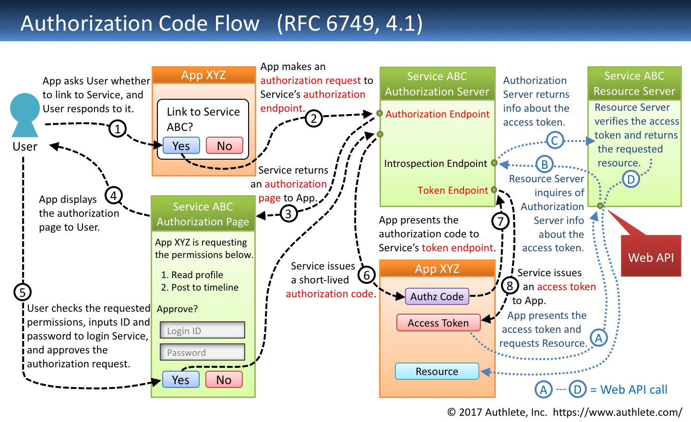
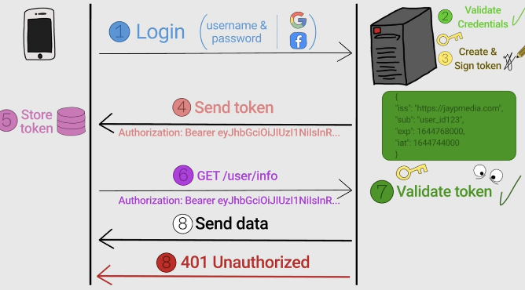
DATABASE & AUTHENTICATION INTEGRATION
MongoDB is used as the database.
Main collections:
Users
Benchmarks
Processes
Email Notifications
Authentication features:
JWT token authentication
Password hashing
Protected API routes
Secure user sessions
This ensures secure access to the application.

Slide 5
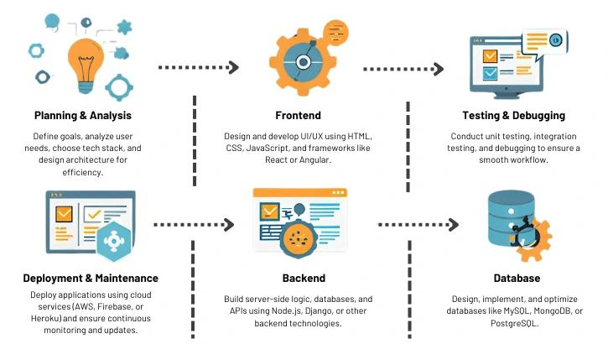
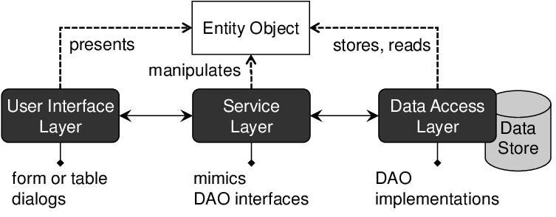
FULLSTACK CRUD IMPLEMENTATION
Implemented complete CRUD operations for benchmarks.
Users can:
Create benchmark data
View benchmark details
Update benchmark metrics
Delete benchmarks
Frontend communicates with backend APIs to update data in real time.

Slide 6
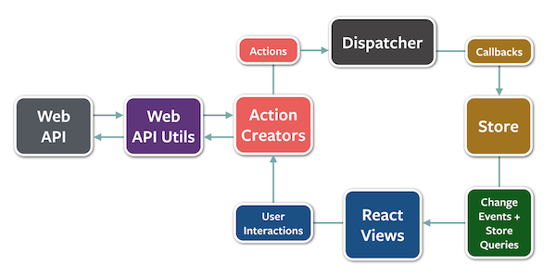
STATE MANAGEMENT
State management implemented using React Context API.
Managed states include:
User authentication state
Benchmark data state
Dashboard analytics state
Application theme state
This ensures smooth data flow between components.

Slide 7
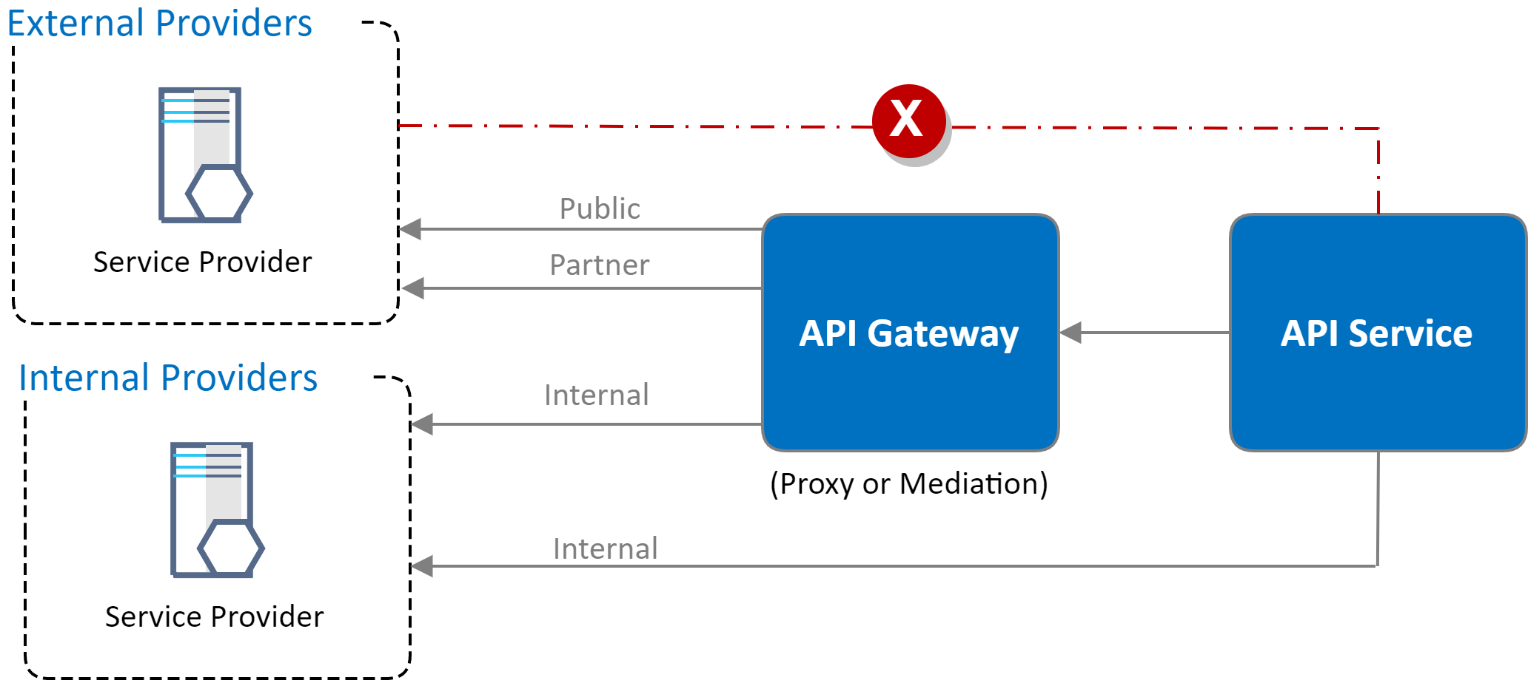
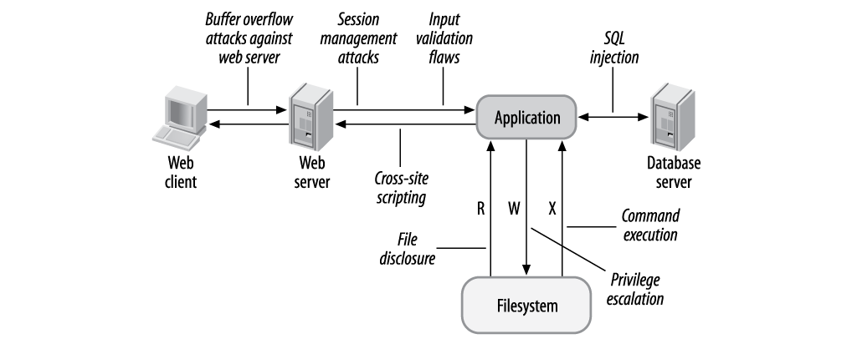
ERROR HANDLING & SECURITY
Implemented multiple security mechanisms.
Security features include:
Server-side input validation
Secure HTTP headers
API error handling middleware
Error logging system
These measures improve system reliability and protection.

Slide 8
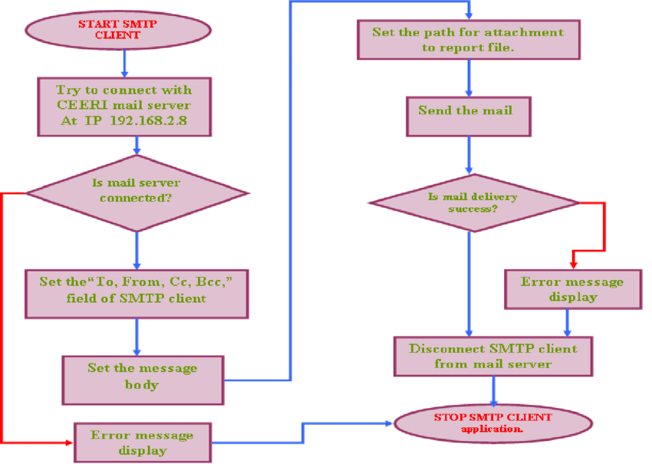
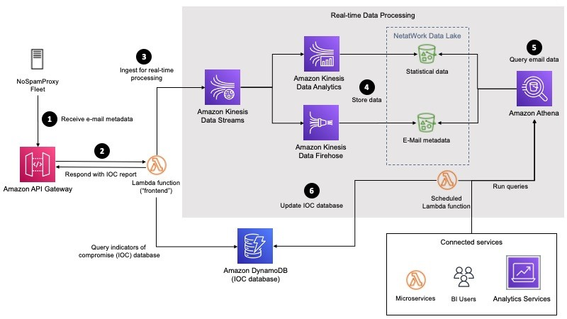
EMAIL REPORT SYSTEM (NEW FEATURE)
Implemented automated email reporting system.
Features:
Automatic email when benchmark is created
Manual email report from Reports dashboard
Email report includes:
Benchmark summary
Average metrics
Individual benchmark details
Performance insights
Emails are sent using SMTP service.

Slide 9
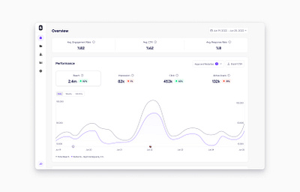
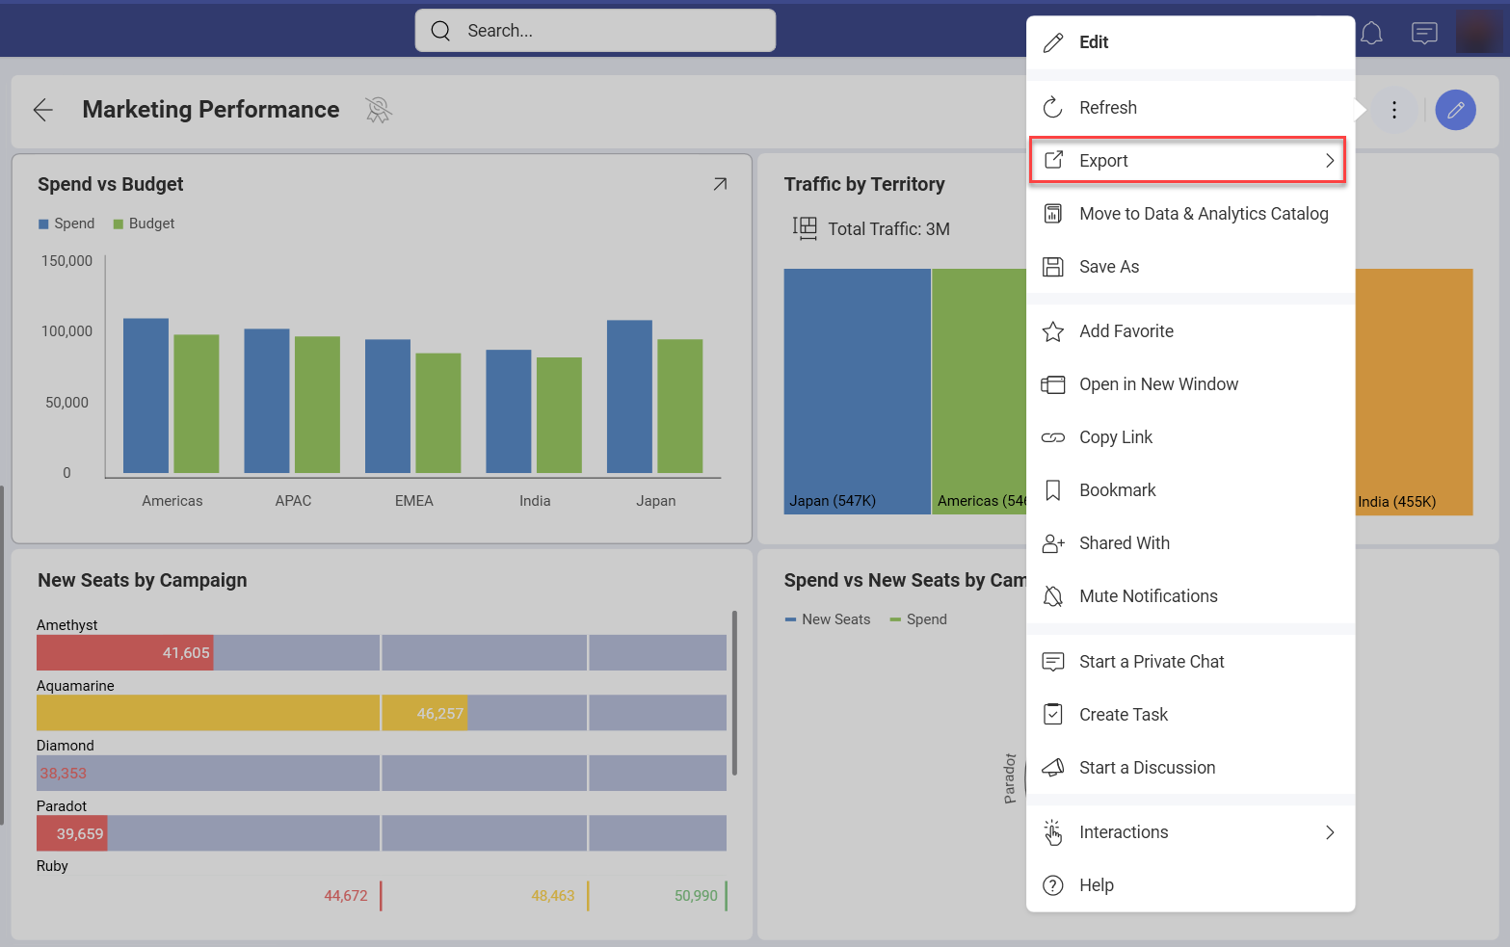
REPORTS MODULE ENHANCEMENTS
Reports page provides advanced reporting features.
Users can:
Send benchmark report to email
Export data as CSV
Export data as JSON
View benchmark summary statistics
This enables easy reporting and external analysis.

Slide 10
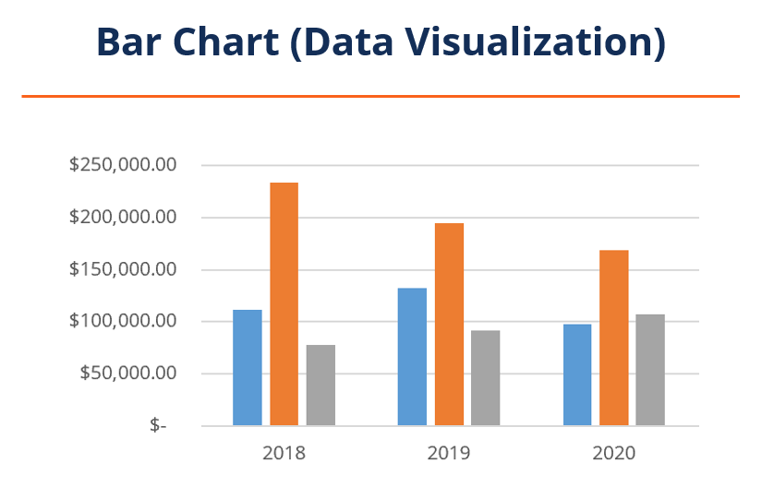
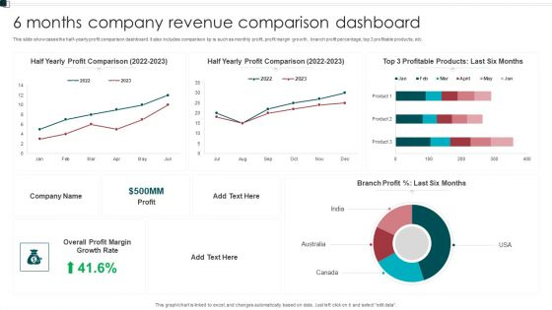
BENCHMARK COMPARISON VISUALIZATION
Implemented bar chart comparison to analyze benchmarks.
Compared metrics:
Conversion Rate
Customer Satisfaction
Operational Efficiency
Revenue Growth
Charts help users quickly identify performance differences.

Slide 11
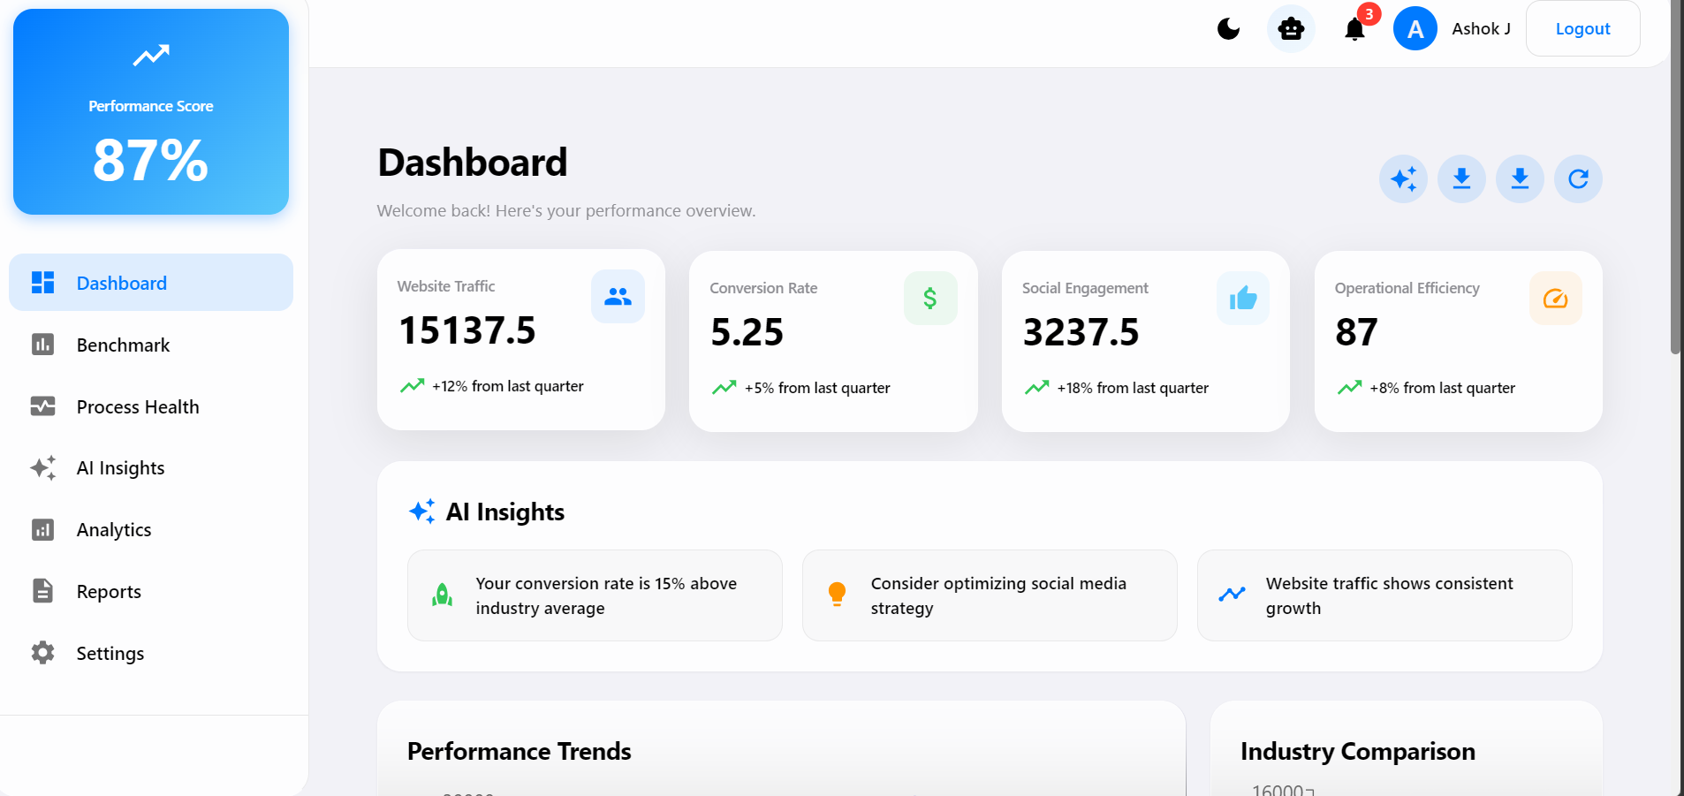
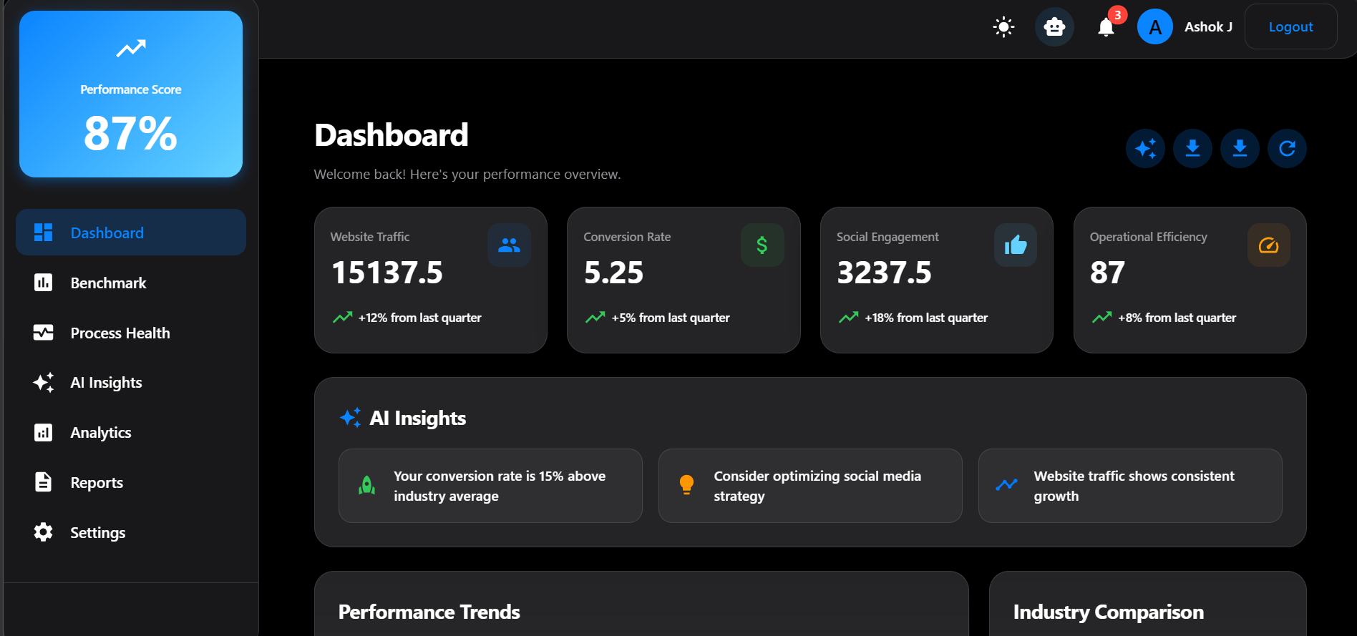
UI ENHANCEMENT & KEY INSIGHTS
User interface upgraded to modern dashboard design.
UI features include:
Light theme (iOS style glossy UI)
Dark theme (professional analytics UI)
Theme toggle switch
Responsive dashboard layout
Metric cards and analytics charts
The system provides insights such as:
Benchmark performance trends
Average performance metrics
Low-performing process detection
Improvement recommendations

Slide 12
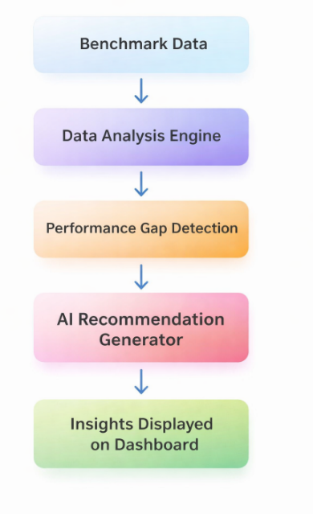
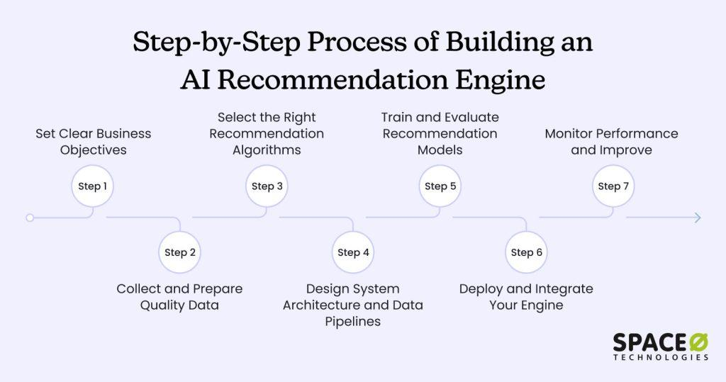
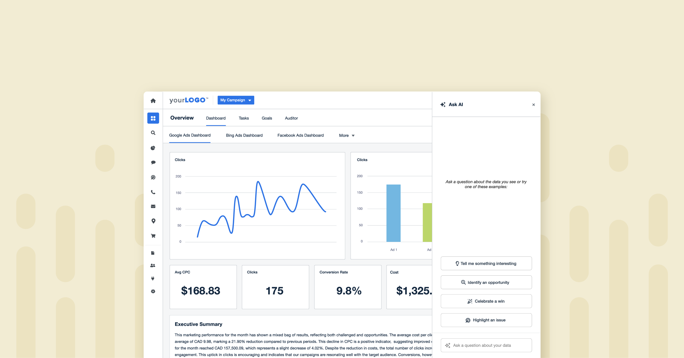
AI INSIGHTS MODULE
AI Analysis Flow
How the AI Module Works
Benchmark data is collected from the database.
The AI analysis engine evaluates performance gaps.
Metrics are compared with benchmark standards.
The system generates improvement recommendations.
Insights are displayed in the AI Insights dashboard.

Slide 13
CONCLUSION
Implemented Backend APIs, Database & Authentication, Full-Stack CRUD, State Management, and Security.
Added new features: AI Insights, Email Report System, Benchmark Comparison Charts, and Data Export (CSV/JSON).
Developed automated Email Report system with benchmark summaries and insights
Enhanced UI dashboard and reporting module for better benchmark analysis and visualization.
Phase 3 will focus on advanced analytics, optimization, and final system improvements.

